Slide 1

DESIGNING A VIRTUAL MEMORY MANAGER
OPERATING SYSTEM

Slide 2

TEAM MEMEBERS
Vivekananda Kappatrala - AP21110011356
Kovvuru Rajesh - AP21110011398
Sai Chakradhar Rao Mahendrakar - AP21110011360
Venkata Ramesh Jangalapalle - AP21110011395

Slide 3
Time line
Project initiation and Planning
System design and architecture
Testing and optimization
Day 1-4
Day 6-9
Day 11-14
Research and requirement
Implementation and coding
Day 4-6
Day 9-11

Slide 4
Methodology
The methodology for designing a virtual memory manager project involves defining project goals, researching virtual memory concepts, identifying project scope, designing the system architecture, defining interfaces, designing data structures and algorithms, implementing the system, integrating and testing, optimizing performance, documenting the project, validating and evaluating the system, and planning for maintenance and updates. Iteration and stakeholder involvement throughout the process are crucial for success.
Implementation proceeds, integrating and testing the virtual memory manager. Optimization and performance tuning are conducted to enhance efficiency. Thorough documentation and user guides are created to facilitate understanding and utilization. The project is validated against goals and requirements, with ongoing maintenance and updates planned to ensure its continued functionality and relevance. Collaboration and feedback from stakeholders are essential throughout the entire process to ensure a successful outcome.
4

Slide 5
WORKING OF THE PROJECT
A virtual memory manager is responsible for managing the virtual memory system of a computer. Virtual memory is a technique that allows the computer to use more memory than physically available by creating an illusion of larger memory space.
Address Translation: When a program running on the computer accesses a memory location, it uses a virtual address. The virtual memory manager translates this virtual address into a physical address, which corresponds to an actual location in the physical memory (RAM).
Memory Mapping: The virtual memory manager maintains a mapping table called the page table, which keeps track of the virtual-to-physical address mappings. The page table is usually stored in the computer's memory.

Slide 6
D
WORKING OF THE PROJECT
Page Fault Handling: When a program tries to access a memory location that is not currently present in the physical memory, a page fault occurs. The virtual memory manager handles this page fault by bringing the required page (a fixed-sized block of memory) from the disk into the physical memory. This process is known as page swapping or paging.
Page Replacement: If the physical memory is full and there are no free pages available, the virtual memory manager needs to make space for the required page. It selects a page from the physical memory, writes it back to the disk if necessary (to free up space), and then brings in the required page. This is known as page replacement, and various algorithms like LRU (Least Recently Used) or FIFO (First-In-First-Out) are used to determine which page to replace.

Slide 7
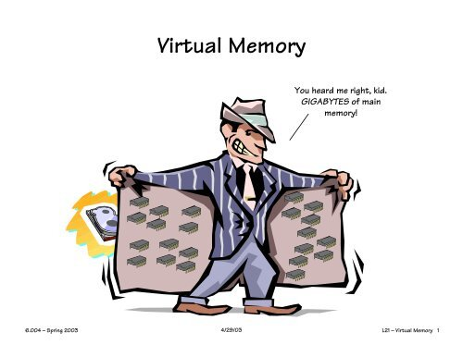

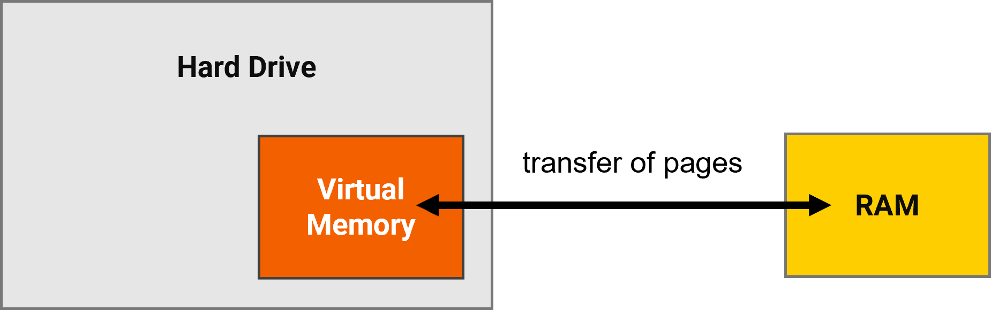
Virtual memory

Slide 8
Summary
c
A virtual memory manager project in an operating system involves creating software that manages the computer's virtual memory system. It translates virtual addresses used by programs into physical memory addresses, handles page faults by bringing required pages from disk to memory, replaces pages when necessary, provides memory protection, and may include swapping processes between memory and disk. The project aims to efficiently utilize memory resources and allow programs to access more memory than physically available..

Slide 9
THANK YOU
c

